Slide 1
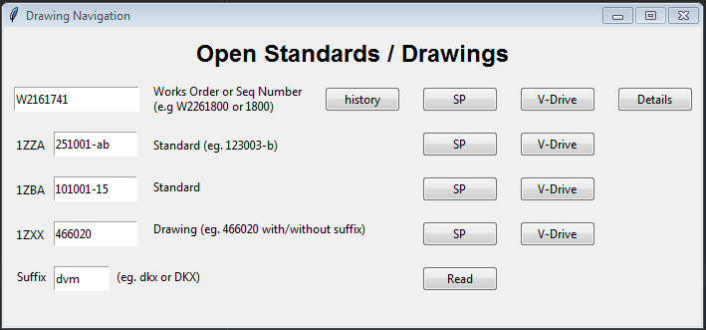
Drawing Opening Program
4
Full works order or sequence number
Works order history window
Opens the entered works order (1.) homepage on SharePoint
Opens the entered works order homepage on V-Drive
Opens the entered WO details
Opens the standards and designs on V-Drive
Reads the suffix entered in 8.) and gives the unit allocated
Opens the standards and designs on SharePoint
Unit suffix
Enter drawing no. without 1ZXX
Enter drawing no. without 1ZBA
Enter drawing no. without 1ZZA
Opens Order Instruction Folder
Engineering documents Folder
Opens Unit specification Folder
Opens Works Order PDFs Folder
Provides suffix of the entered WO (1.)
2
3
5
1
12
11
10
9
8
7
6

Slide 2
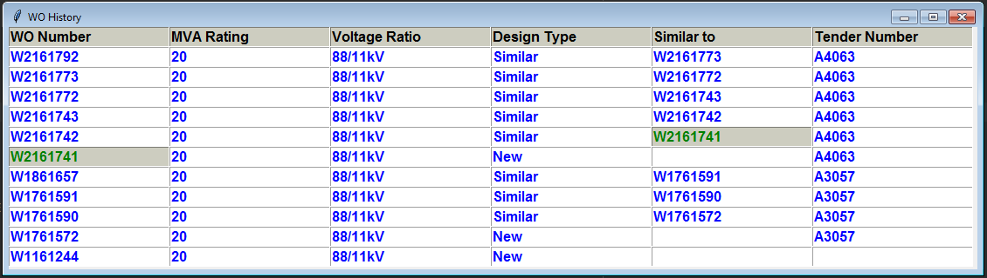
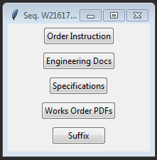
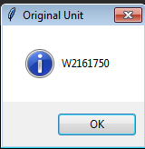
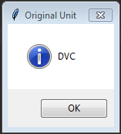
Drawing Opening Program
CLICKED 2
Entered WO
CLICKED 7
CLICKED 17
CLICKED 5
13
14
15
16
17

